Slide 1
Collection for Insertions - Queues

Slide 2
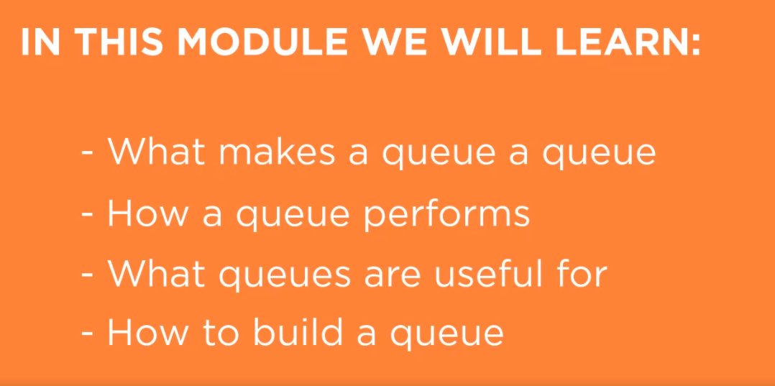

Slide 3








What Is a Queue?
“A queue is an ordered line or sequence”
Chaotic mess of people
4th 3rd 2nd 1st

Slide 4




Queue Characteristics
Big O ?
O(1)
O(1)
O(n)
O(n)
enQueue deQueue Search Access
“I’m first off to the powder, FIFO’s rule”
Queues
Stacks

Slide 5
Demo
Create queue class
Underlying queue structure

Slide 6

Demo
Create size method
Create insert/delete methods (enQueue/ deQueue)

Slide 7
Demo
Create contains method
Create access method

Slide 8

Snowbird Lift Queue Test

Slide 9
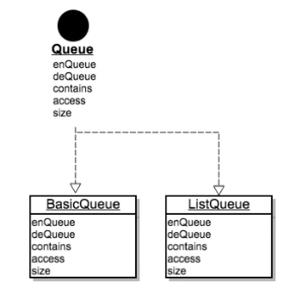
Queue Extra Credit
Homework
•
•
•
Create a Queue interface
Make the BasicQueue implement it Change the Snowbird lift app code to use the Queue interface
Create a new ListQueue using ArrayList as the
underlying structure
Change the Snowbird lift app code to use the ListQueue
•
Queue queue = new BasicQueue(); •
queue.enQueue(“In Line”); Object item = queue.deQueue();

Slide 10


Core Java Queues
Queue<E>
https://docs.oracle.com/javase/ 8/docs/api/java/util/Queue.html
ArrayBlockingQueue, ArrayDeque, ConcurrentLinkedDeque, ConcurrentLinkedQueue, DelayQueue, LinkedBlockingDeque, LinkedBlockingQueue, LinkedList, LinkedTransferQueue, PriorityBlockingQueue, PriorityQueue, SynchronousQueue

Slide 11

What is a queue?
Summary
Built basic queue class and underlying structure
Insert, delete and size methods Contains and access methods Improving the basic queue Java Queue

